Slide 1
Agenda
Terraform: Infrastructure as Code
What is Terraform?
How does Terraform work?
Terraform Lifecycle
Core Concepts
Types
Modules
Loops
Terraform with Azure

Slide 2
What is Terraform?
An open-source infrastructure as Code (IaC) tool by HashiCorp where you can store your cloud infrastructure setup as code.
Define and provision the infrastructure using a declarative language HCL (HashiCorp Configuration Language).
Supports multiple providers such as AWS, Azure, GCP, DigitalOcean and many more.
Supports client only architecture, so no need for additional configuration management on a server.
Notes:
Input Variables - Configuration Language | Terraform by HashiCorp

Slide 3
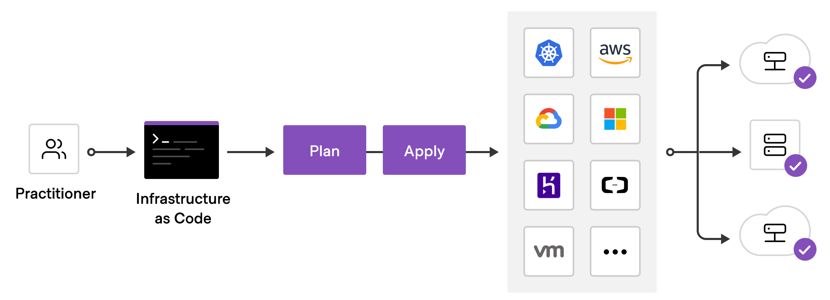
How does Terraform work?
https://learn.hashicorp.com/
Notes:
Automating infrastructure deployments in the Cloud with Terraform and Azure Pipelines | Azure DevOps Hands-on-Labs (azuredevopslabs.com)
Terraform with Azure DevOps Pipeline (telstra.com)

Slide 4
Terraform Lifecycle
Init - Initialize the working directory which consists of all the config files.
Plan - Create an execution plan to reach a desired state of the infrastructure. Apply - Makes the changes in the infrastructure as defined in the plan, and the infrastructure comes to the desired state.
Destroy - Delete all the old infrastructure resources, which are marked tainted after the apply phase.
Init
Plan
Apply
Destroy
Notes:
Variables: Also used as input-variables, it is key-value pair used by Terraform modules to allow customization.
Provider: It is a plugin to interact with APIs of service and access its related resources.
Module: It is a folder with Terraform templates where all the configurations are defined
State: It consists of cached information about the infrastructure managed by Terraform and the related configurations.
Resources: It refers to a block of one or more infrastructure objects (compute instances, virtual networks, etc.), which are used in configuring and managing the infrastructure.
Data Source: It is implemented by providers to return information on external objects to terraform.
Output Values: These are return values of a terraform module that can be used by other configurations.
Plan: It is one of the stages where it determines what needs to be created, updated, or destroyed to move from real/current state of the infrastructure to the desired state.
Apply: It is one of the stages where it applies the changes real/current state of the infrastructure in order to move to the desired state.

Slide 5
Core Concepts
Variables: Used as input-variables, it is key-value pair used by Terraform modules to allow customization.
Provider: A plugin to interact with APIs of service and access its related resources.
Module: A folder with Terraform templates where all the configurations are defined.
State: Consists of cached information about the infrastructure managed by Terraform and the related configurations.
Resources: Refers to a block of one or more infrastructure objects (compute instances, virtual networks), which are used in configuring and managing the infrastructure.
Notes:
Variables: Also used as input-variables, it is key-value pair used by Terraform modules to allow customization.
Provider: It is a plugin to interact with APIs of service and access its related resources.
Module: It is a folder with Terraform templates where all the configurations are defined
State: It consists of cached information about the infrastructure managed by Terraform and the related configurations.
Resources: It refers to a block of one or more infrastructure objects (compute instances, virtual networks, etc.), which are used in configuring and managing the infrastructure.
Data Source: It is implemented by providers to return information on external objects to terraform.
Output Values: These are return values of a terraform module that can be used by other configurations.
Plan: It is one of the stages where it determines what needs to be created, updated, or destroyed to move from real/current state of the infrastructure to the desired state.
Apply: It is one of the stages where it applies the changes real/current state of the infrastructure in order to move to the desired state.

Slide 6
Core Concepts
Data Source: Implemented by providers to return information on external objects to terraform.
Output Values: These are return values of a terraform module that can be used by other configurations.
Plan: One of the stages where it determines what needs to be created, updated, or destroyed to move from real/current state of the infrastructure to the desired state.
Apply: One of the stages where it applies the changes real/current state of the infrastructure in order to move to the desired state.
Notes:
Variables: Also used as input-variables, it is key-value pair used by Terraform modules to allow customization.
Provider: It is a plugin to interact with APIs of service and access its related resources.
Module: It is a folder with Terraform templates where all the configurations are defined
State: It consists of cached information about the infrastructure managed by Terraform and the related configurations.
Resources: It refers to a block of one or more infrastructure objects (compute instances, virtual networks, etc.), which are used in configuring and managing the infrastructure.
Data Source: It is implemented by providers to return information on external objects to terraform.
Output Values: These are return values of a terraform module that can be used by other configurations.
Plan: It is one of the stages where it determines what needs to be created, updated, or destroyed to move from real/current state of the infrastructure to the desired state.
Apply: It is one of the stages where it applies the changes real/current state of the infrastructure in order to move to the desired state.

Slide 7
Type
String
Number
Bool
Any
List
Map
object
Notes:
JSON Configuration Syntax - Configuration Language | Terraform by HashiCorp

Slide 8
Modules
Containers for multiple resources that are used together.
Used to package and reuse resource configurations with Terraform.
Every Terraform configuration has at least one module, known as its root module, which consists of the resources defined in the .tf files in the main working directory.
A module that has been called by another module is often referred to as a child module.
Child modules can be called multiple times within the same configuration, and multiple configurations can use the same child module.

Slide 9
Loops
Count: Allows you to specify a whole number, and produces as many instances of something as this number tells it to.
For_each: Provide a variable - map, or a set of strings, and the resources can access values contained within, via each.key and each.value.
For: Iterating over, and operating on things from complex collections. Imagine that you have a list of words (strings), but unfortunately, all of them contain newline characters at the end which you don’t want.

Slide 10
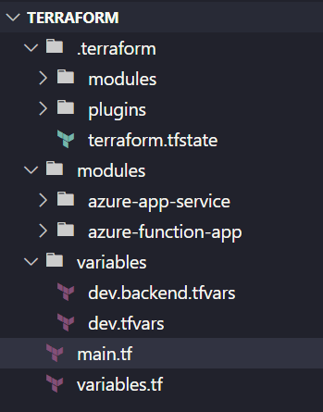
Terraform with Azure
Notes:
Build Infrastructure - Terraform Azure Example | Terraform - HashiCorp Learn
Terraform best practices for Azure (javaadpatel.com)

Slide 11
DEMO
Terraform with Azure

